Slide 1

E-Commerce 2018: Business. Technology. Society
Fourteenth Edition
Chapter 12
B2B E-Commerce: Supply Chain Management and Collaborative Commerce
Copyright © 2019, 2018, 2017 Pearson Education, Inc. All Rights Reserved
Notes:
If this PowerPoint presentation contains mathematical equations, you may need to check that your computer has the following installed:
1) MathType Plugin
2) Math Player (free versions available)
3) NVDA Reader (free versions available)

Slide 2
Learning Objectives
12.1 Discuss the evolution and growth of B2B e-commerce, as well as its potential benefits and challenges..
12.2 Understand how procurement and supply chains relate to B2B e-commerce.
12.3 Identify major trends in supply chain management and collaborative commerce.
12.4 Understand the different characteristics and types of Net marketplaces.
12.5 Understand the objectives of private industrial networks, their role in supporting collaborative commerce, and the barriers to their implementation.
Notes:
Slide 2 is list of textbook LO numbers and statements

Slide 3
Amazon Takes on B2b with Amazon Business
Class Discussion
What made the difference in Amazon Business moving from being a distributer of supplies to a real B2B marketplace?
What benefits over other B2B marketplaces does Amazon Business offer buyers?
What benefits do suppliers have in using Amazon Business?
Does Amazon Business pose any disadvantages for buyers or sellers?

Slide 4
Trends in B2B E-Commerce
Flexibility: growing emphasis on rapid-response and optimal supply chains
Resurgence in Net marketplaces bringing together hundreds of suppliers and thousands of buying firms
Supply chain visibility—real time
Social/mobile commerce and customer intimacy
Cloud computing
Big data and growing use of business analytics
Internet of Things
Accountable and sustainable supply chains

Slide 5
Basic Definitions
B2B commerce:
All types of computer-enabled inter-firm trade
Before Internet, B2B transactions called trade or procurement process
B2B e-commerce:
The portion of B2B commerce enabled by the Internet
Supply chains
Organizations, people, business processes, technology, information required to produce products efficiently
Often global

Slide 6
The Evolution of B2B Commerce
Automated order-entry systems
Seller-side solution
Electronic data interchange (E D I)
Buyer-side solution
Hub-and-spoke system
Serve vertical markets
B2B e-commerce websites
Net marketplaces
Private industrial networks

Slide 7
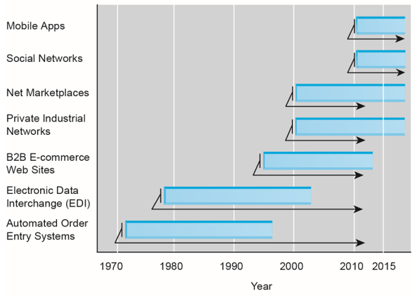
Figure 12.1 Evolution of the Use of Technology Platforms in B2B Commerce
Notes:
Figure 12.1, Page 778
B2B e-commerce has gone through many stages of development since the 1970s. Each stage reflects a major change in technology platforms from mainframes to private dedicated networks, and finally to the Internet, mobile apps and social networks.

Slide 8
The Growth of B2B E-Commerce (1 of 2)
B2B e-commerce will grow to 50% of total U.S. inter-firm trade by 2021
Private industrial networks continue to play dominant role in B2B
Non-E D I B2B e-commerce most rapidly growing type of e-commerce
E D I continues as workhorse of B2B commerce

Slide 9
The Growth of B2B E-Commerce (2 of 2)
Not all industries similarly affected by B2B e-commerce
Not all industries would benefit equally
Factors influencing move to e-commerce
Significant utilization of E D I
Large investments in I T and Internet infrastructure
Market concentrated on purchasing or selling

Slide 10
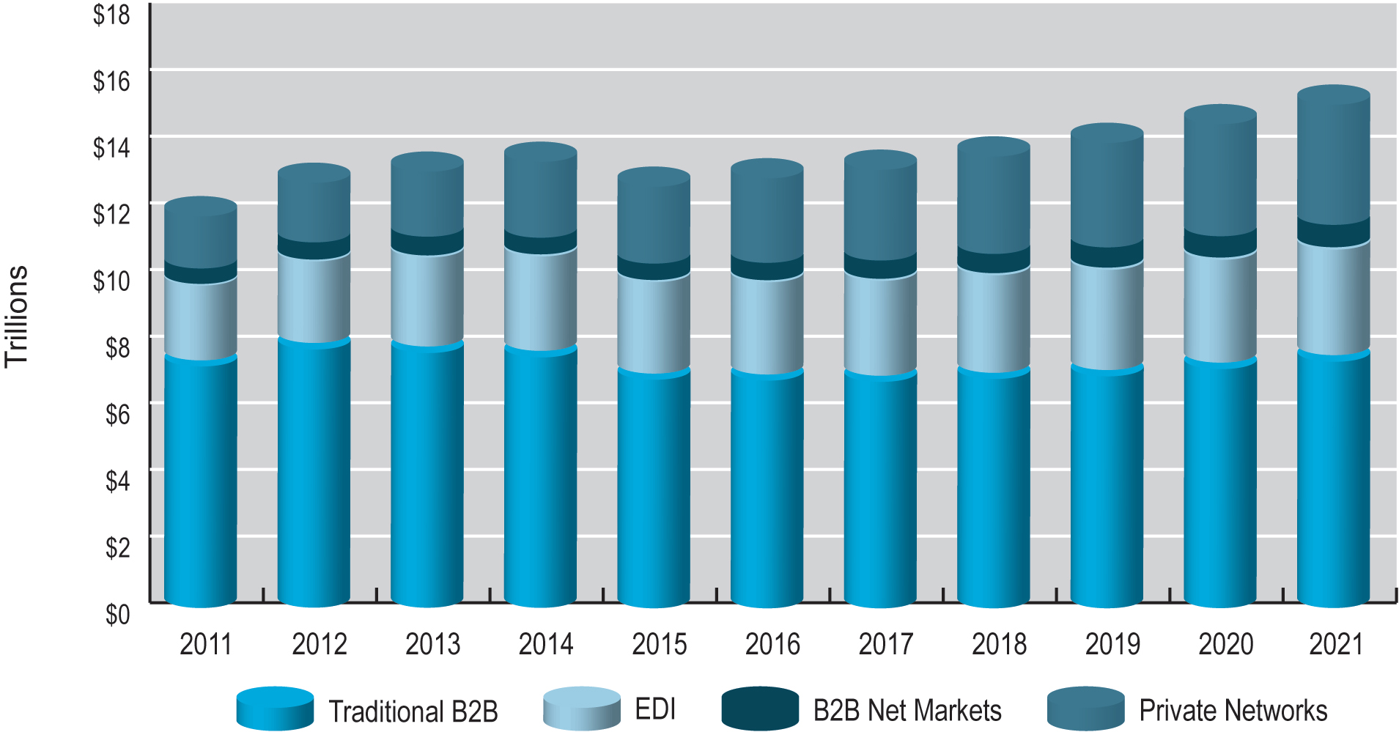
Figure 12.2 Growth of B2b E-Commerce in the United States
Notes:
Figure 12.2, Page 780

Slide 11
Potential Benefits and Challenges of B2B E-Commerce (1 of 2)
Lower administrative costs
Lower search costs for buyers
Reduced inventory costs
Lower transaction costs
Increased production flexibility by ensuring just-in-time parts delivery
Improved quality of products by increasing cooperation among buyers and sellers

Slide 12
Potential Benefits and Challenges of B2B E-Commerce (2 of 2)
Decreased product cycle time
Increased opportunities for collaboration
Greater price transparency
Increased visibility, real-time information sharing
However, some risk is posed by increased globalization and consolidation

Slide 13
Insight on Society: Where’s My ipad? Supply Chain Risk and Vulnerability
Class discussion:
Why does concentrating production on fewer suppliers also concentrate risk?
How does globalization play a part in increased risk?
What types of procedures could be implemented, given increased globalization, to reduce risk?

Slide 14
The Procurement Process and the Supply Chain
Procurement process:
The way firms purchase materials they need to make products
Steps in procurement process
Deciding who to buy from and what to pay
Completing transaction
Each step is composed of many business processes and subactivities requiring data to be recorded in seller, buyer, and shipper information systems

Slide 15
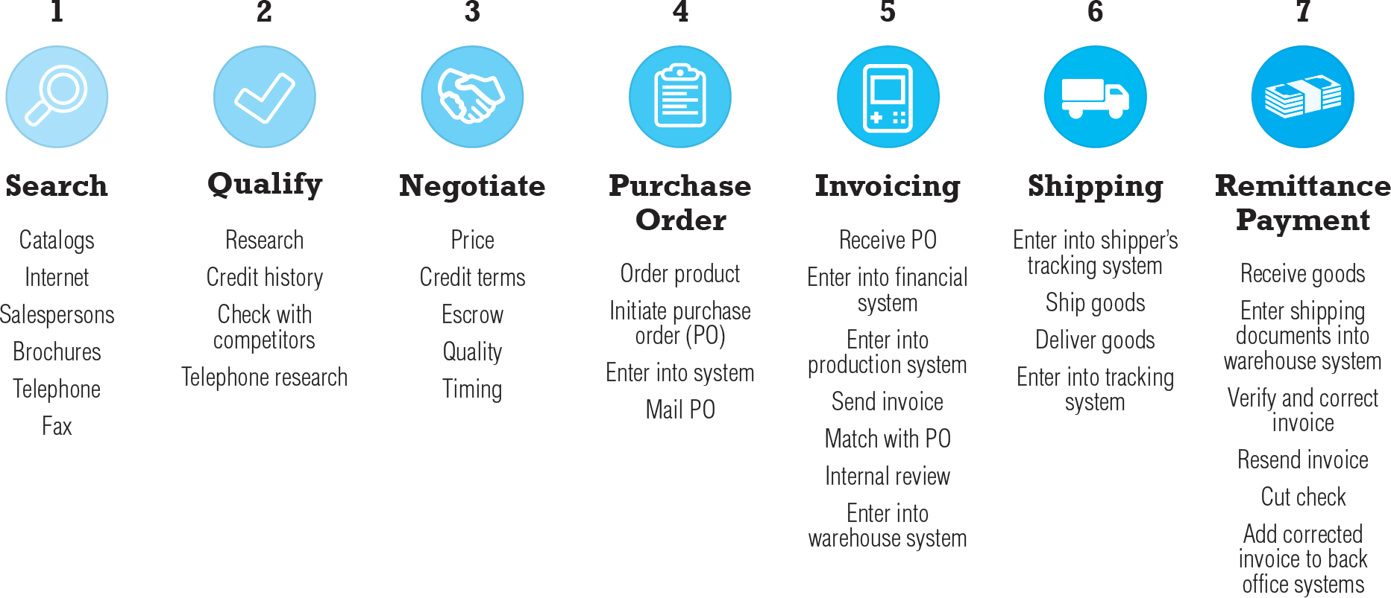
Figure 12.3 The Procurement Process
Notes:
Figure 12.3, Page 784
The procurement process is a lengthy and complicated series of steps that involves the seller, buyer, and shipping companies in a series of connected transactions.

Slide 16
Types of Procurement (1 of 2)
Firms purchase two types of goods
Direct goods: Integrally involved in production process
Indirect goods: All goods not directly involved in production process (M R O goods)
Firms use two methods to purchase
Contract purchasing:
Involves long-term written agreements to purchase specified products, with agreed-upon terms and quality
Spot purchasing:
Involves purchase of goods based on immediate needs in larger marketplaces that involve many suppliers

Slide 17
Types of Procurement (2 of 2)
Procurement is highly information intensive and labor intensive
Requires managing information among many corporate systems
Involves over 1 million U.S. workers
Purchasing managers
Key players in procurement process
Key decision-makers for adoption of B2B e-commerce solutions

Slide 18
Multi-Tier Supply Chain
Complex series of transactions between firm and thousands of suppliers, supplying thousands of goods
Challenges
Supply chain visibility
Demand forecasting
Production scheduling
Order management
Logistics management

Slide 19
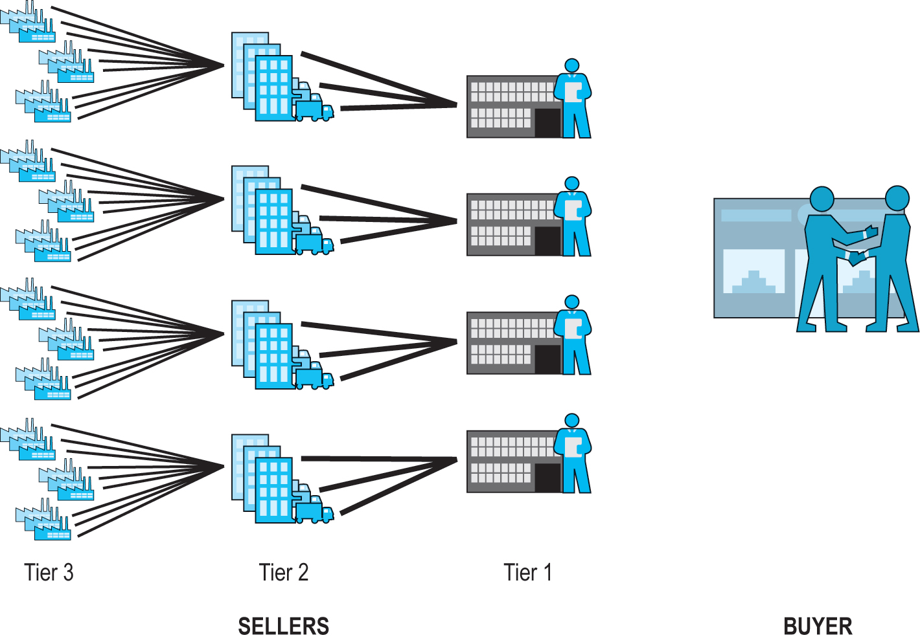
Figure 12.4 The Multi-Tier Supply Chain
Notes:
Figure 12.4, Page 786.
The supply chain for every firm is composed of multiple tiers of suppliers.

Slide 20
The Role of Existing Legacy Computer Systems
Legacy computer systems
Generally, older mainframe and minicomputer systems used to manage key business processes within firm
Enterprise systems
Corporate-wide
Support/control all aspects of production, including
Procurement
Finance
Human resources

Slide 21
Trends in Supply Chain Management
Supply chain management (S C M)
Activities used to coordinate procurement process
Major trends in S C M
Continual efforts to improve process
Trends include: Just-in-time and lean production, supply chain simplification, adaptive supply chains, sustainable supply chains, electronic data interchange, supply chain management (S C M) systems

Slide 22
Just-In-Time and Lean Production
Just-in-Time production
Method of inventory cost management
Seeks to keep excess inventory at a bare minimum
Lean production
Set of production methods and tools
Focuses on elimination of waste throughout customer value chain, not just inventory

Slide 23
Supply Chain Simplification
Reducing size of supply chain
Working with strategic group of suppliers to reduce product and administrative costs and improve quality
Essential for just-in-time production models
May involve:
Joint product development and design
Integration of computer systems
Tight coupling
Ensuring precise delivery of ordered parts at specific times

Slide 24
Adaptive Supply Chains
Reducing centralization
Reduce risks caused by relying on single suppliers who are subject to local instability
For example: European financial crisis, Japanese earthquake
Creating regional- or product-based supply chains
Allowing production to be moved to temporary safe harbors in case of local manufacturing disruptions
Focus on “optimal-cost”, distributed manufacturing, and flexible supply chains that can shift to low-risk areas

Slide 25
Accountable Supply Chains
Labor conditions in low-wage, under-developed producer countries are acceptable to consumers
Slave/forced and child labor
Routine exposure to toxic substances
More than 48 hours/week
Harassment, abuse, and sexual exploitation
Adequate compensation
Efforts to make global supply chains more accountable and transparent to reporters and citizens
Fair Labor Association
National Consumers League, Human Rights First, and more

Slide 26
Sustainable Supply Chains
Taking social and ecological interests into account
For example: water usage, air pollution
Using most efficient environment for production, distribution, logistics
Good business, over long-term
Good risk management
Create value for consumers, investors, communities

Slide 27
Electronic Data Interchange (E D I)
Communications protocol for exchanging documents among computers
Each industry has own standards
Developed in 1970s, 80s to automate exchange and reduce cost and errors in purchase orders, shipping documents, and more
Today, provides for exchange of critical business information between computer applications supporting wide variety of business processes
Suited to small set of strategic partners

Slide 28
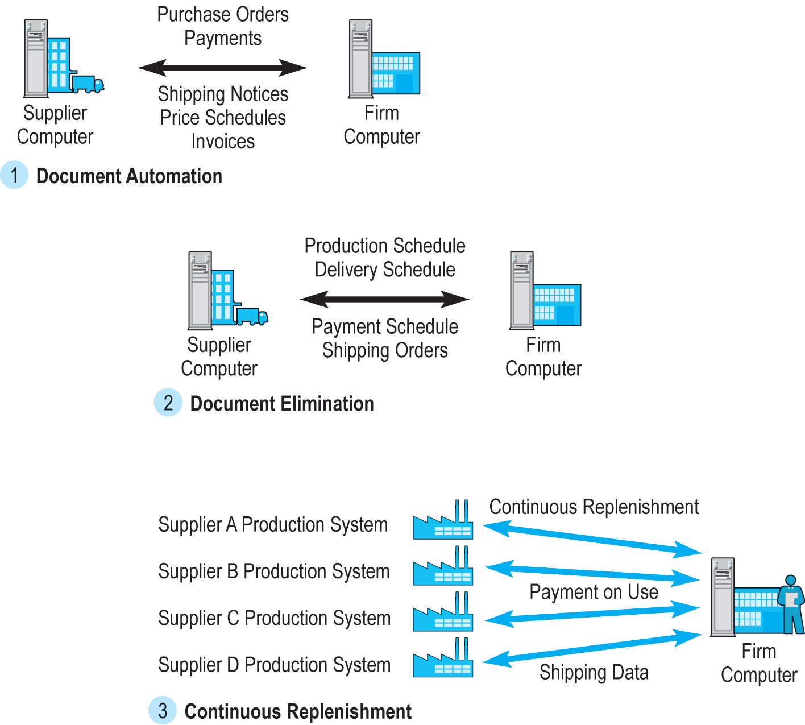
Figure 12.5 The Evolution of E D I as a B2B Medium
Notes:
Figure 12.5; Page 793
EDI has evolved from a simple point-to-point digital communications medium to a many-to-one enabling tool for continuous inventory replenishment.

Slide 29
Mobile B2B
Mobile devices increasingly important in all aspects of B2B e-commerce
Used in all phases of purchase process
Users increasingly expect B2B e-commerce sites to be accessible from mobile devices
Bring Your Own Device (B Y O D) policies
Supply chain software and network providers providing support for mobile platform

Slide 30
B2B in the Cloud
Cloud-based B2B systems
Shift much of the expense of B2B systems from firm to B2B network provider (data hub or B2B platform)
Cloud platform owner provides
Computing/telecommunications capabilities
Software
Connectivity
Data cleansing and quality
File storage
Network effects: Costs spread out over all members
Cloud-based solutions can be implemented rapidly

Slide 31
Insight on Technology: Your Shoes Are in the Cloud
Class discussion:
What challenges did Wolverine face in its global supply chain?
What factors led Wolverine to move to a cloud-based supply chain platform?
What advantages does a cloud-based platform provide? Are there any disadvantages?

Slide 32
Supply Chain Management Systems
Continuously link activities of buying, making, and moving products from suppliers to purchasing firms
S A P and Oracle Mobile apps for smartphones, tablets
Integrates demand side of business equation by including order entry system in the process
With S C M system and continuous replenishment, inventory is eliminated and production begins only when order is received
Hewlett Packard’s S C M system: Elapsed time from order entry to shipping P C is 48 hours

Slide 33
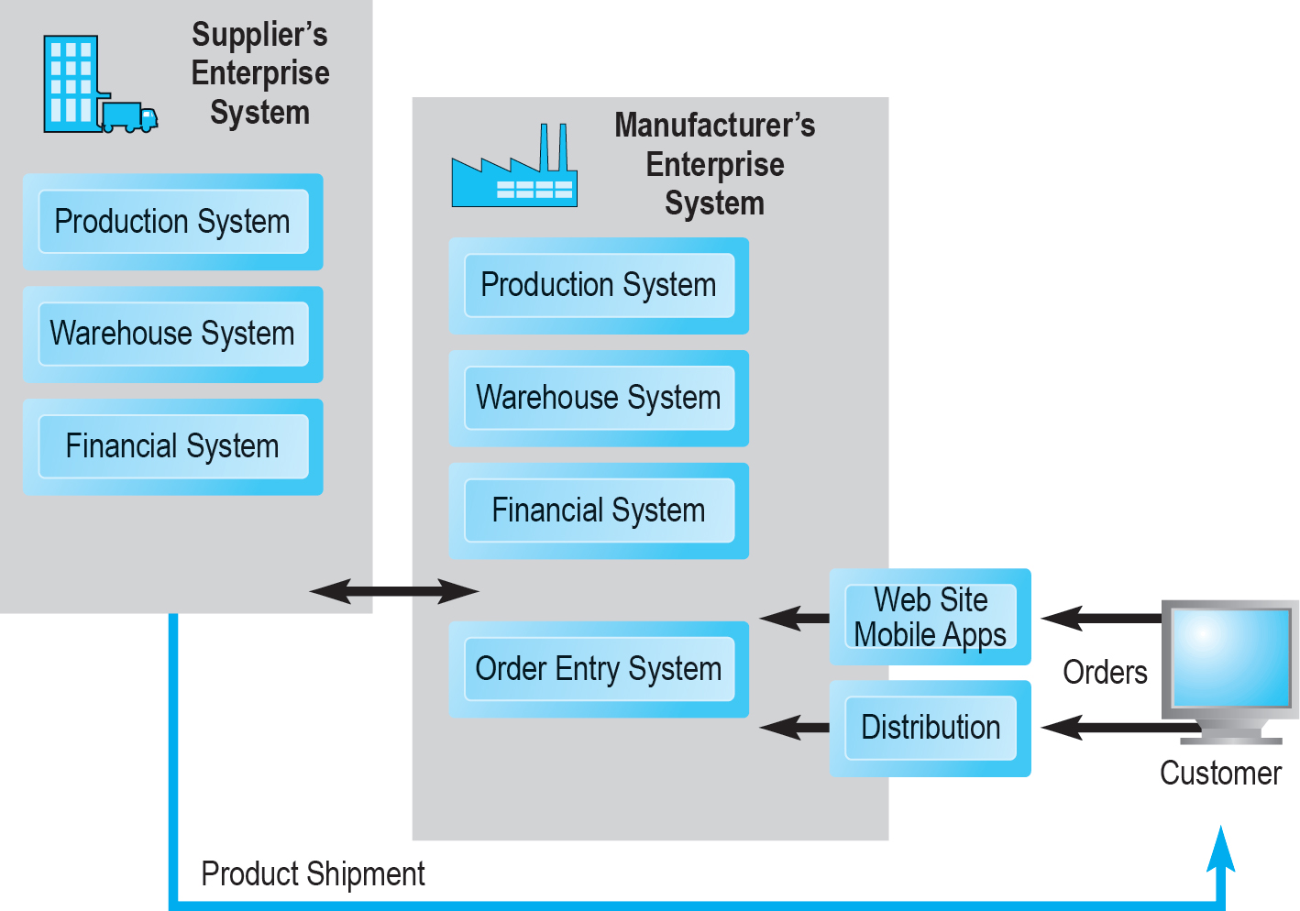
Figure 12.7 Supply Chain Management Systems
Notes:
Figure 12.7, Page 799
SCM systems coordinate the activities of suppliers, shippers, and order entry systems to automate order entry through production, payment, and shipping business processes. Increasingly customers, as well as employees working throughout the supply chain, are using smartphones, tablets, and mobile apps to place and coordinate orders.

Slide 34
Collaborative Commerce
Use of digital technologies for organizations to collaboratively design, produce, and manage products through life cycles
Moves focus from transactions to relationships among supply chain participants
Unlike E D I, more like an interactive teleconference among members of supply chain
Use of Internet technologies for rich communications environment
Sharing designs, documents, messages, network meetings, videconferencing

Slide 35
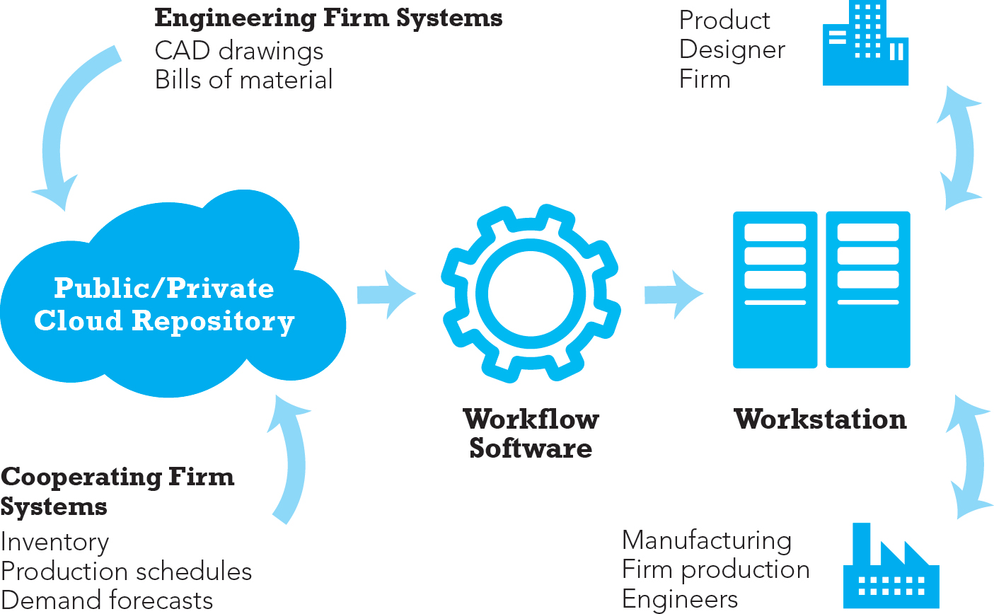
Figure 12.8 Elements of a Collaborative Commerce System
Notes:
Figure 12.8, Page 801
A collaborative commerce application includes a cloud repository where employees at several different firms can store engineering drawings and other documents. Workflow software determines who can see this data and what rules will apply for displaying the data on individual workstations.

Slide 36
Social Networks and B2B
Social networks can provide personal connections that can help decision making in supply chain
Example: Dell’s YouTube channel
Example: Cisco’s Facebook pages for product campaigns for business clients

Slide 37
B2B Marketing
More interpersonal than traditional retail marketing
B2B contract selling
Very long-standing relationships between suppliers and buyers
Spot purchase markets for M R O, commodities
More similar to B2C marketing tactics
Mobile advertising
Predictive analytics
Sales enablement systems

Slide 38
Net Marketplaces
Ways to classify Net marketplaces:
Pricing mechanism, nature of market served, ownership
By business functionality
What businesses buy (direct versus. indirect goods)
How businesses buy (spot purchasing versus. long-term sourcing)
Four main types
E-distributors
E-procurement
Exchanges
Industry consortia

Slide 39
Table 12.3 Characteristics of Net Marketplaces: A B2B Vocabulary
Characteristic | Meaning
Bias | Sell-side versus. buy-side versus. neutral. Whose interests are advantaged: buyers, sellers, or no bias?
Ownership | Industry versus. third party. Who owns the marketplace?
Pricing mechanism | Fixed-price catalogs, auctions, bid/ask, and R F P s/R F Q s
Scope/focus | Horizontal versus. vertical markets
Value creation | What benefits do they offer customers or suppliers?
Access to market | In public markets, any firm can enter, but in private markets, entry is by invitation only

Slide 40
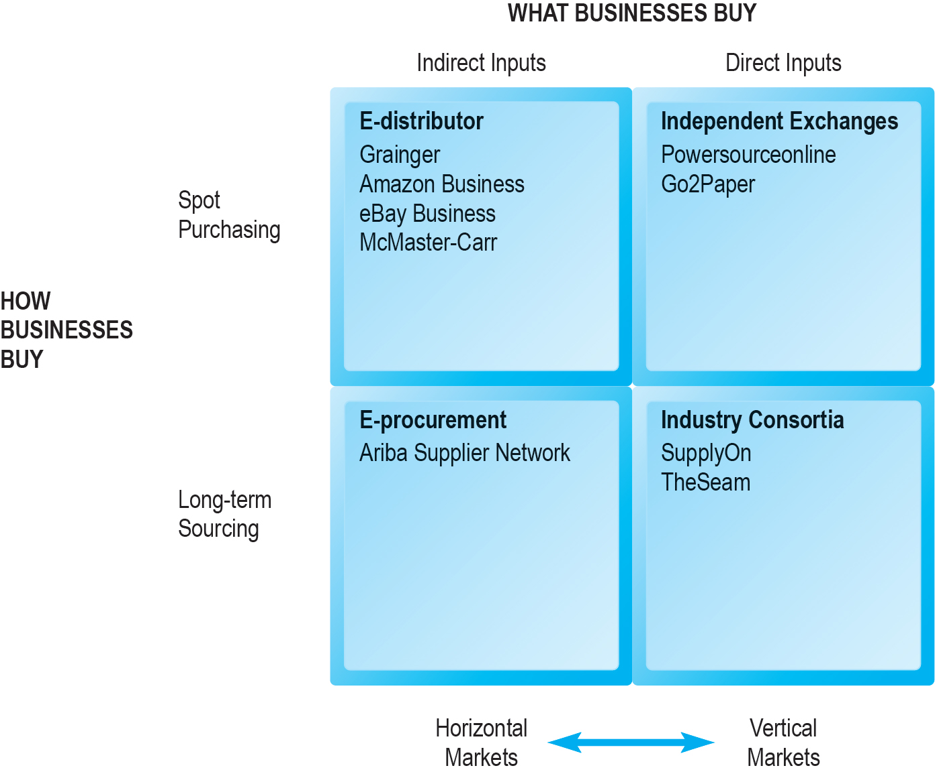
Figure 12.9 Pure Types of Net Marketplaces
Notes:
Figure 12.9, Page 805
There are four main types of Net marketplaces based on the intersection of two dimensions: how businesses buy and what they buy. A third dimension—horizontal versus vertical markets—also distinguishes the different types of Net marketplaces.

Slide 41
E-Distributors
Most common type of Net marketplace
Electronic catalogs representing products of thousands of direct manufacturers
Typically, independently owned intermediaries
Offer industrial customers single source to purchase indirect goods (M R O) on spot basis
Typically, horizontal
Usually, fixed price discounts for large customers
Example: W.W. Grainger, Amazon Business

Slide 42
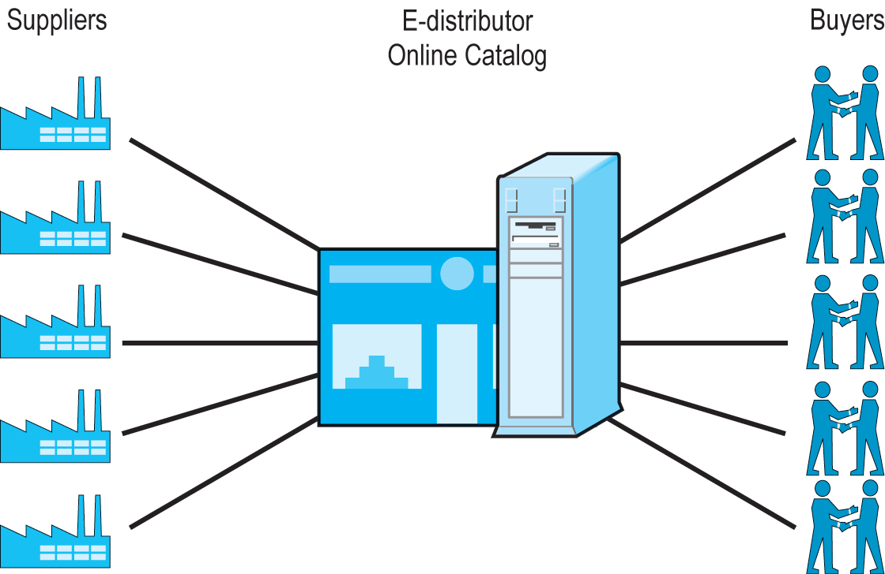
Figure 12.10 E-Distributors
Notes:
Figure 12.10, Page 806
E-distributors are firms that bring the products of thousands of suppliers into a single online catalog for sale to thousands of buyer firms. E-distributors are sometimes referred to as one-to-many markets, one seller serving many firms.

Slide 43
E-Procurement Net Marketplaces
Independently owned intermediaries
Connect hundreds of suppliers of indirect goods
Firms pay fees to join market
Long-term contractual purchasing of indirect goods
Revenues from transaction fees, licensing consultation services and software, network fees
Offer value chain management (V C M) services
Many-to-many market
Example: Ariba

Slide 44
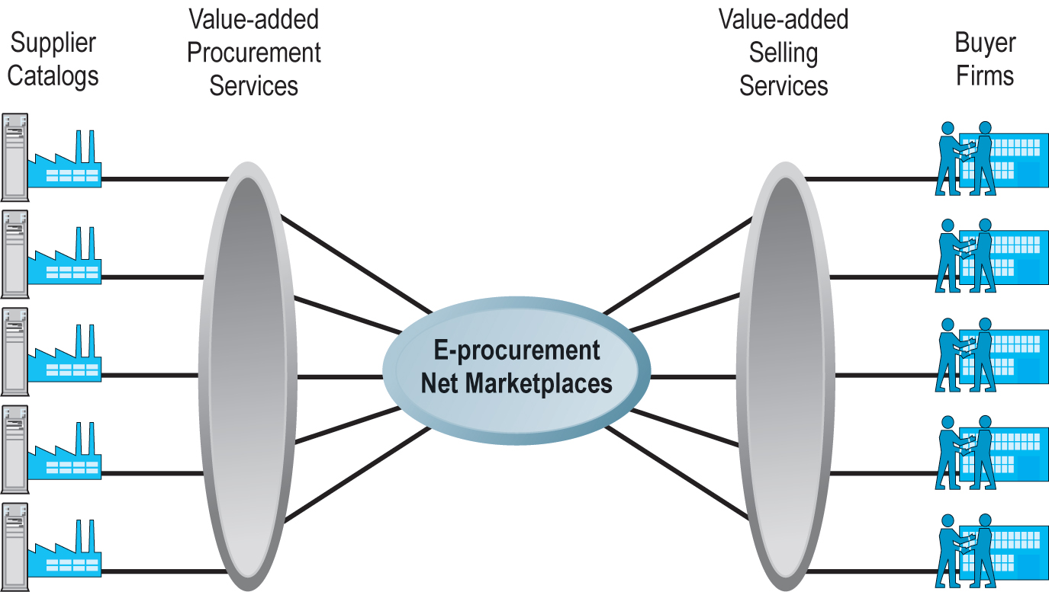
Figure 12.11 E-Procurement Net Marketplaces
Notes:
Figure 12.11, Page 807
E-procurement Net marketplaces aggregate hundreds of catalogs in a single marketplace and make them available to firms, often on a custom basis that reflects only the suppliers desired by the participating firms.

Slide 45
Exchanges
Independently owned online marketplaces
Connect hundreds to thousands of suppliers and buyers in dynamic, real-time environment
Vertical market, spot purchasing, single industry
Typically charge commission fees on transaction
Tend to be buyer-biased; suppliers disadvantaged by competition
Many have failed due to low liquidity

Slide 46
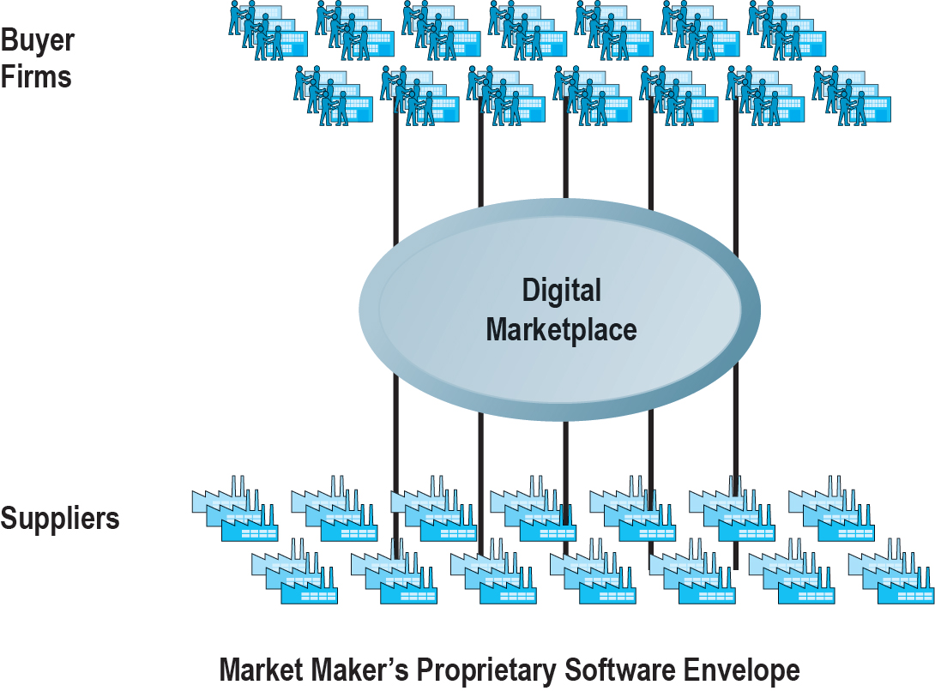
Figure 12.12 Exchanges
Notes:
Figure 12.12, Page 809
Independent exchanges bring potentially thousands of suppliers to a vertical (industry-specific) marketplace to sell their goods to potentially thousands of buyer firms. Exchanges are sometimes referred to as many-to-many markets because they have many suppliers serving many buyer firms.

Slide 47
Industry Consortia
Industry-owned vertical markets
Purchase of direct inputs from set of invited participants
Emphasize long-term contractual purchasing, stable relationships, creation of data standards
Aim to unify supply chain within entire industry through common platform
Revenue from transaction and subscription fees

Slide 48
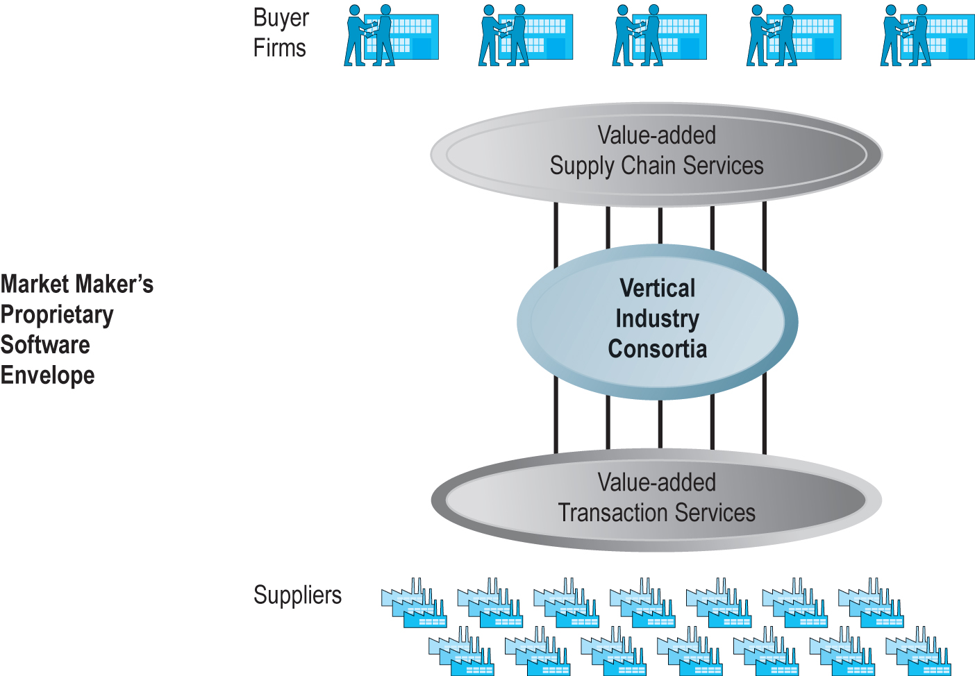
Figure 12.13 Industry Consortia
Notes:
Figure 12.13, Page 811
Industry consortia bring thousands of suppliers into direct contact with a smaller number of very large buyers. The market makers provide value-added software services for procurement, transaction management, shipping, and payment for both buyers and suppliers. Industry consortia are sometimes referred to as many-to-few markets, where many suppliers (albeit selected by the buyers) serve a few very large buyers, mediated by a variety of value-added services.

Slide 49
Private Industrial Networks (1 of 2)
Most prevalent form of B2B e-commerce
Web-enabled networks for coordination of trans-organizational business processes (collaborative commerce)
Direct descendant of E D I; closely tied to E R P systems
Manufacturing and support industries
Single, large manufacturing firm sponsors network
Range in scope from single firm to entire industry
Example: Procter & Gamble

Slide 50
Private Industrial Networks (2 of 2)
Objectives include:
Efficient purchasing and selling industry-wide
Increasing supply chain visibility
Closer buyer–supplier relationships
Global scale operations
Focus on continuous business process coordination
Typically, focus on single sponsoring company that “owns” the network

Slide 51
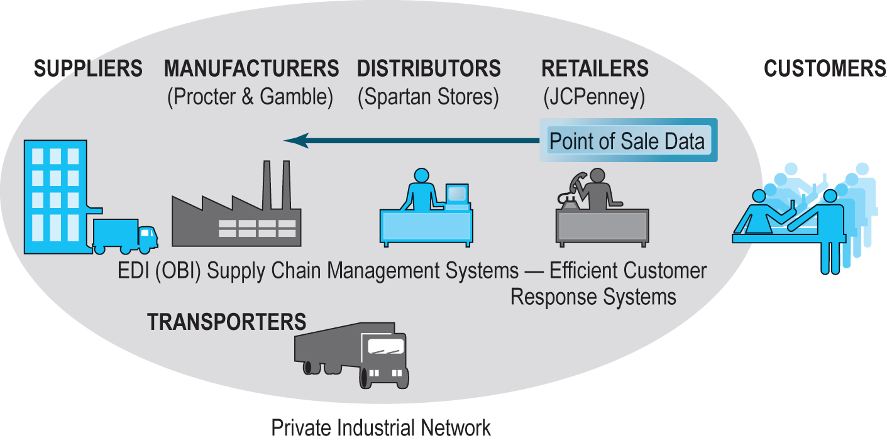
Figure 12.14 P&G’s Private Industrial Network
Notes:
Figure 12.14, Page 814
Procter & Gamble’s private industrial network attempts to coordinate the trans-organizational business processes of the many firms it deals with in the consumer products industry.

Slide 52
Insight on Business: Walmart Develops a Private Industrial Network
Class discussion:
What is Walmart’s Retail Link system and how has it changed since the early 1990s?
What functionality does Walmart’s G R S provide?
Why did Walmart have a inventory problem beginning in 2014?
Why has Walmart had difficulty competing with Amazon?

Slide 53
Private Industrial Networks and Collaborative Commerce
Forms of collaboration:
Collaborative resource planning, forecasting, and replenishment (C P F R):
Demand chain visibility
Marketing coordination and product design
Can ensure products fulfill claims of marketing
Feedback enables closed loop marketing

Slide 54
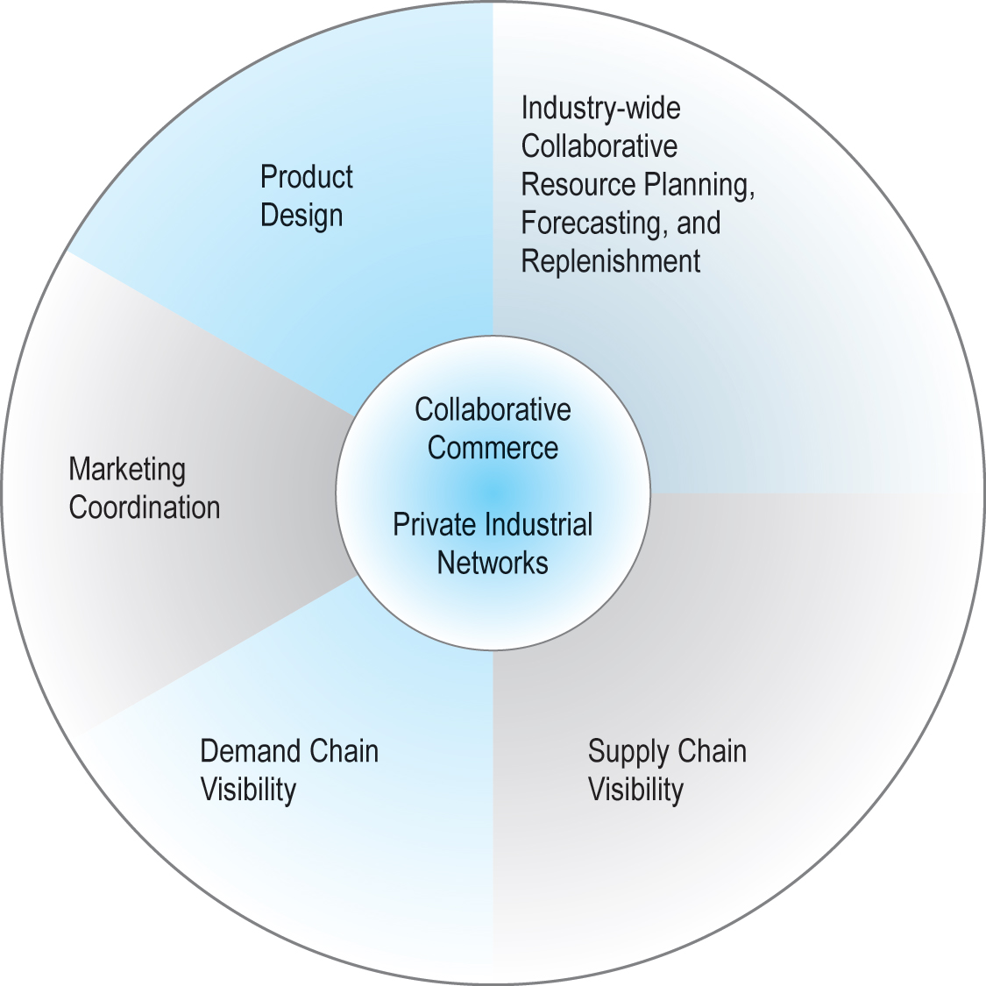
Figure 12.15 Pieces of the Collaborative Commerce Puzzle
Notes:
Figure 12.15, page 818
Collaborative commerce involves many cooperative activities among supply and sales firms closely interacting with a single large firm through a private industrial network.

Slide 55
Implementation Barriers
Concerns about sharing of proprietary, sensitive data
Integration of private industrial networks into existing E R P systems and E D I networks difficult, expensive
Requires change in mindset and behavior of employees and suppliers
All participants lose some independence

Slide 56
Careers in E-Commerce
Position: Junior Supply Chain Analyst
Qualification/Skills
Preparing for the Interview
Possible Interview Questions

Slide 57

Copyright

